Slide 1
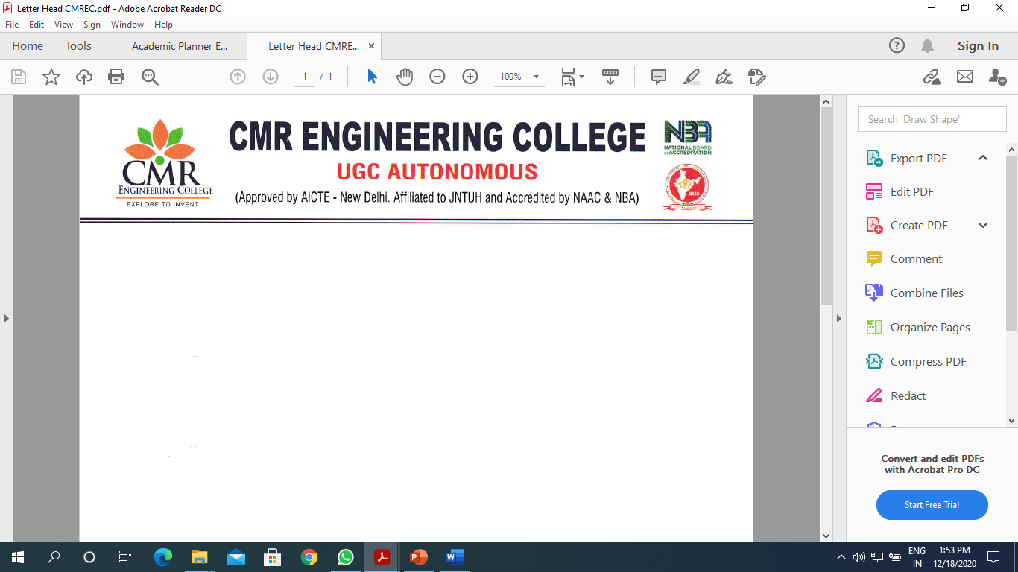
DEPARTMENT OF CSE-CYBER SECURITY
A Major project on
Fake Social Media Profile Detection And Reporting
UNDER THE GUIDANCE OF : SUBMITTED BY:
Mr.M.Ramasamy G.Ashlesha-208R1A6217
Assistant Professor, K.Jagadish-208R1A6237
Department of CSE-cyber security, P .Rajshekar Reddy-208R1A6248
CMREC. Srinath tekale-208R1A6258

Slide 2
CONTENTS
Abstract
Introduction
Literature survey
Existing System
Proposed System
Modules or Implementation
Screenshot Input And Output
Conclusion
Future enhancement.
Reference

Slide 3
ABSTRACT
In present times, social media plays a key role in every individual life. Every day majority of the people spend their time on social media platforms.
The number of accounts in these social networking sites has dramatically increased day-by-day and many of the users are interacting with others irrespective of their time and location.
Hence, this research aims to detect fake users based on the user's profile using ANN, which can detect fake accounts with more accuracy than other algorithms.

Slide 4
INTRODUCTION
Modern society, social media plays a vital role in everyone's life. The general purpose of social media is to keep in touch with friends, sharing news, etc. The number of users on social media is increasing exponentially.
Instagram has recently gained immense popularity among social media users. With more than 1 Billion active users, Instagram has become one of the most used social media sites. These social media influencers have now become a go-to place for business organizations to advertise their products and services.
Using Social media for online fraud, and spreading False information is increasing at a rapid pace. Fake accounts are the major source of false information on social media.

Slide 5

Business organizations that invest huge Sum of money in social media influencers must know whether the following gained by that account is organic or not. So, there is a widespread need for a fake account detection tool, which can accurately say whether the account is fake or not.
The process of finding a fake account mainly depends on factors such as engagement rate and artificial activity.

Slide 6
LITERATURE REVIEW
Meligy, A.M., Ibrahim, H.M. and Torky, M.F., 2017. Identity verification mechanism for detecting fake profiles in online social networks. Int. J. Comput. Netw. Inf. Secure.(IJCNIS), 9(1), pp.31-39.
Ramalingam, D. and Chinnaiah, V., 2018. Fake profile detection techniques in large-scale online social networks: A comprehensive review. Computers & Electrical Engineering, 65, pp.165-177.
Wanda, P. and Jie, H.J., 2020. Deep Profile: Finding fake profiles in online social networks using dynamic CNN. Journal of Information Security and Applications, 52, p.102465.
Zhang, J., Dong, B. and Philip, S.Y., 2020, April. Fake detector: Effective fake news detection with a deep diffusive neural network. In 2020 IEEE 36th International Conference on Data Engineering (ICDE) (pp. 1826-1829). IEEE.

Slide 7
EXISTING SYSTEM
In existing system, SVM algorithm and Random forest algorithm are used .
Less Accuracy
Time consuming
Less efficient

Slide 8
PROPOSED SYSTEM
Proposed system is used to detect fake social media profiles by using ANN algorithm which gave better accuracy.
Proposed system considering various factors like
Accuracy
Time
Cost

Slide 9
Software and hardware requirements
SOFTWARE REQUIREMENTS
Operating system : Windows 10 Ultimate
Coding Language : Python.
Framework : Tkinter (GUI framework)
HARDWARE REQUIREMENTS
System : Intel core i3(Minimum).
Hard Disk : 200 GB.
Monitor : 14’ Color Monitor.
Mouse : Optical Mouse.
Ram : 4 GB.

Slide 10
MODULES:
1. Upload Social Network Profiles Dataset:
Using this module we will upload the dataset to the application
2. Preprocess Dataset:
Using this module we will apply processing techniques such as removing missing values and then split the dataset into train and test where the application uses 80% dataset to train ANN and 20% dataset to test ANN prediction accuracy
3. Run ANN Algorithm:
Using this module we will train the ANN algorithm with train and test data and then the train model will be generated and we can use this train model to predict fake accounts from the new dataset.

Slide 11
4. ANN Accuracy & Loss Graph:
To train the ANN model we are taking 200 epoch/iterations and then in the graph, we will plot the accuracy/loss performance of ANN at each epoch/iteration.
5. Predict Fake/Genuine Profile using ANN:
Using this module we will upload new test data and then apply the ANN train model to predict whether test data is genuine or fake.

Slide 12
IMPLEMENTATION
PYTHON:
Python is a simple, general purpose, high level, and object-oriented programming language.
Python is an interpreted scripting language also. Guido Van Rossum is known as the founder of Python programming.
Python is an easy-to-learn yet powerful and versatile scripting language, which makes it attractive for Application Development.
With its interpreted nature, Python's syntax and dynamic typing make it an ideal language for scripting and rapid application development.
Python supports multiple programming patterns, including object-oriented, imperative, and functional or procedural programming styles.
Python is not intended to work in a particular area, such as web programming. It is a multipurpose programming language because it can be used with web, enterprise, 3D CAD, etc.

Slide 13
FEATURES
Free and Open Source.
Easy to code.
Easy to Read.
Object-Oriented Language.
GUI Programming Support.
High-Level Language.
Large Community Support.
Easy to Debug.

Slide 14
TKINTER
Python offers multiple options for developing GUI (Graphical User Interface). Out of all the GUI methods, tkinter is the most commonly used method.
It is a standard Python interface to the Tk GUI toolkit shipped with Python.
Python provides the standard library Tkinter for creating the graphical user interface for desktop based applications.
Developing desktop based applications with python Tkinter is not a complex task. An empty Tkinter top-level window can be created by using the following steps.
import the Tkinter module.
Create the main application window.
Add the widgets like labels, buttons, frames, etc. to the window.
Call the main event loop so that the actions can take place on the user's computer screen.

Slide 15
ALGORITHM ANN:
The term "Artificial neural network" refers to a biologically inspired sub-field of artificial intelligence modeled after the brain.
Input layer – The activity of the input units represents the raw information that can feed into the network.
Hidden layer – To determine the activity of each hidden unit. The activities of the input units and the weights on the connections between the input and the hidden units. There may be one or more hidden layers.
Output layer – The behavior of the output units depends on the activity of the hidden units and the weights between the hidden and output units.

Slide 16
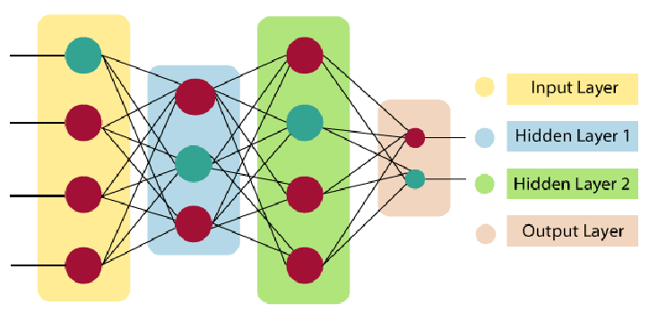
To understand the concept of the architecture of an artificial neural network, we have to understand what a neural network consists of. In order to define a neural network that consists of a large number of artificial neurons, which are termed units arranged in a sequence of layers

Slide 17
UML Diagrams use case

Slide 18
CLASS DIAGRAM
COLLABORATION DIAGRAM

Slide 19
SEQUENCE DIAGRAM

Slide 20
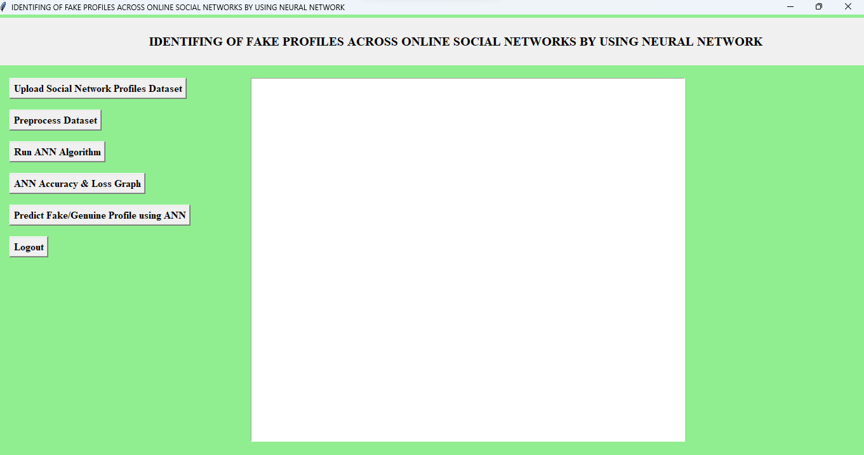
Output screens:

Slide 21
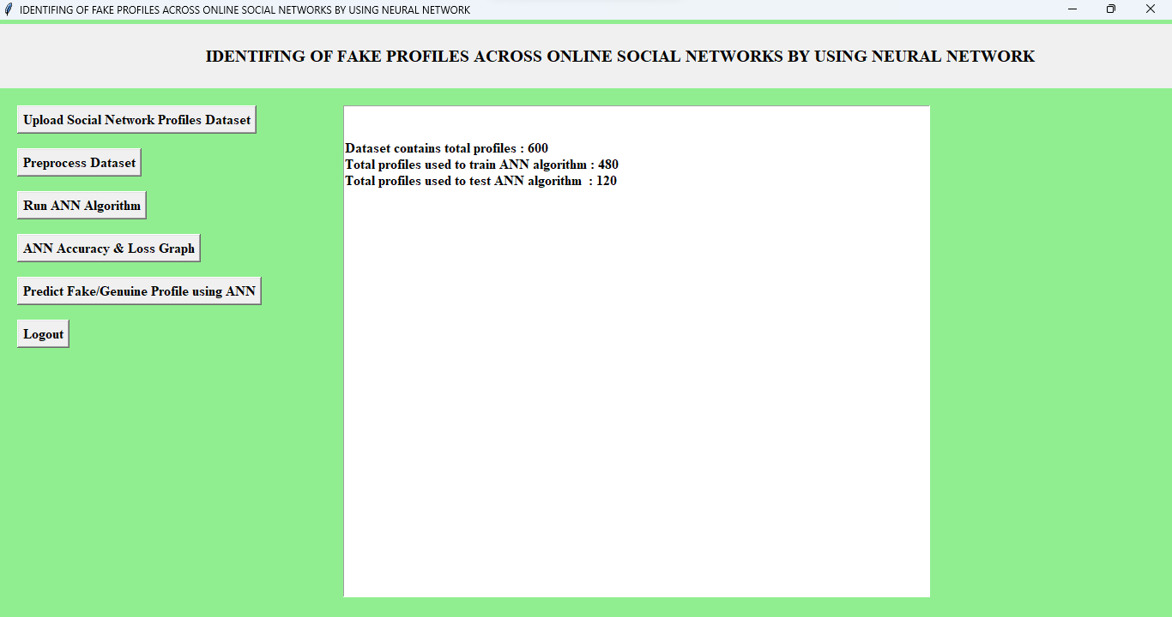

Slide 22
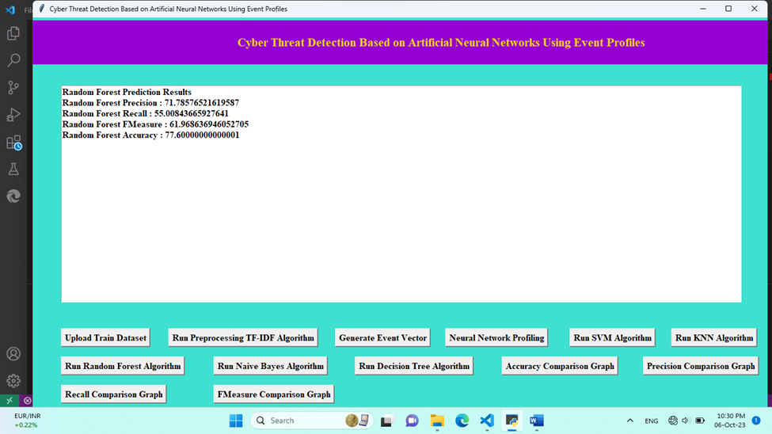
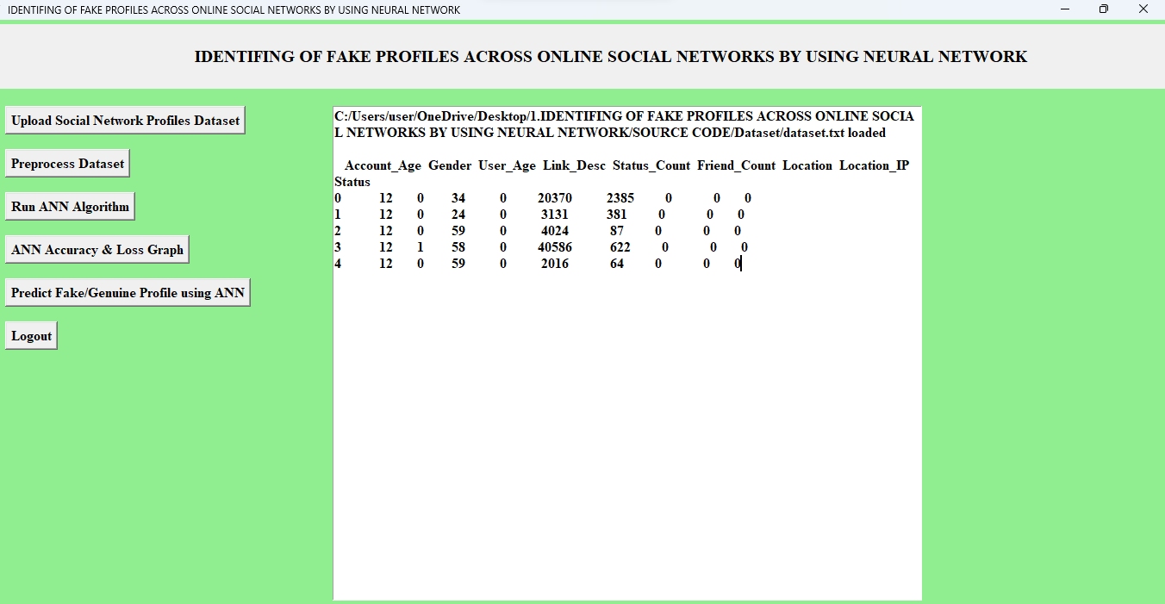

Slide 23
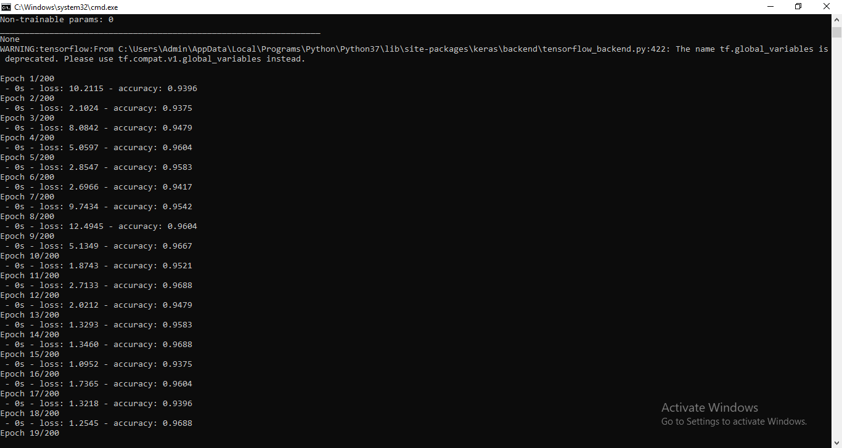

Slide 24
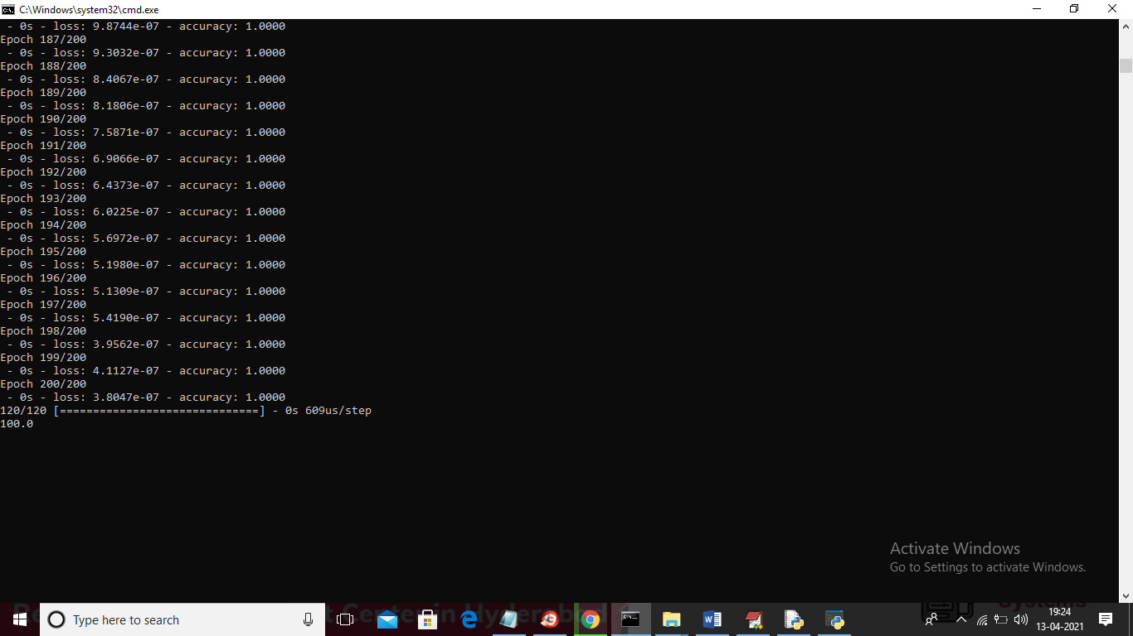

Slide 25
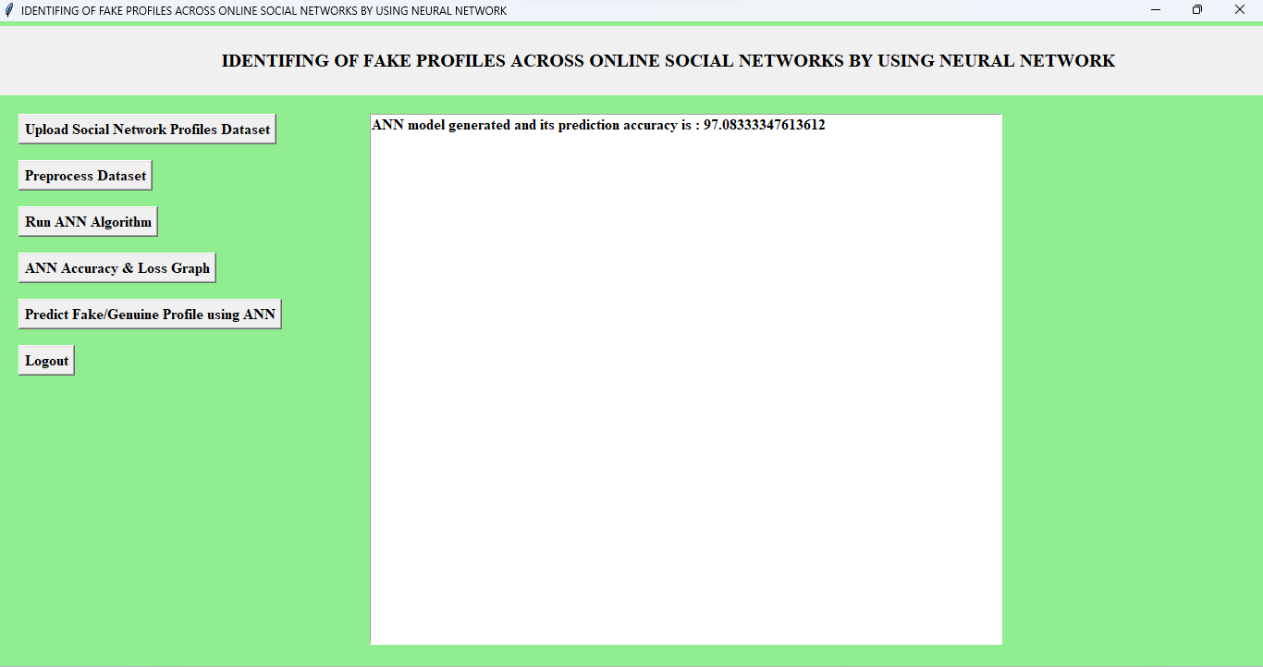

Slide 26
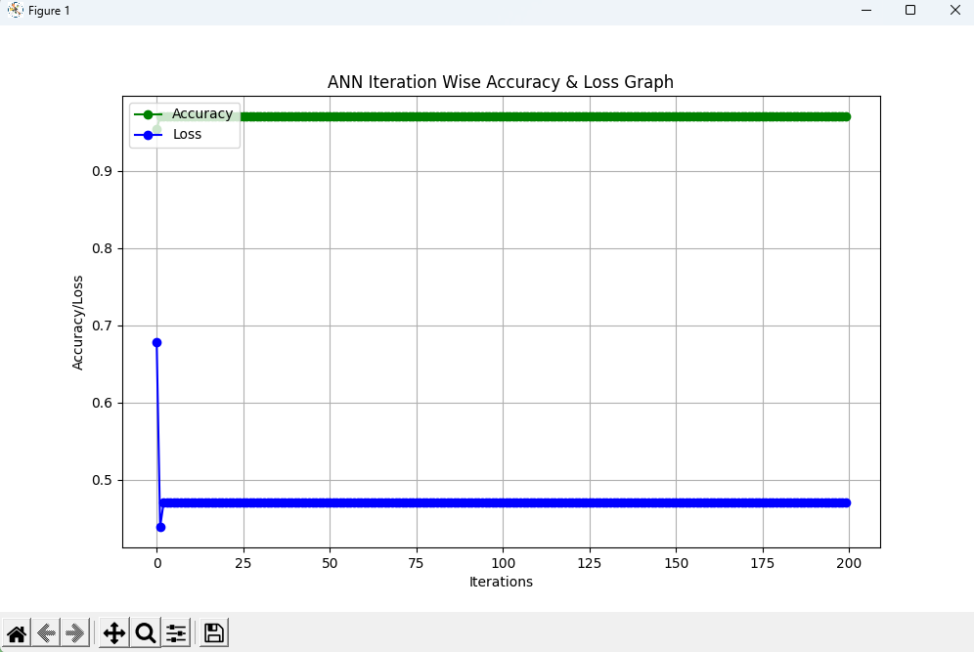

Slide 27
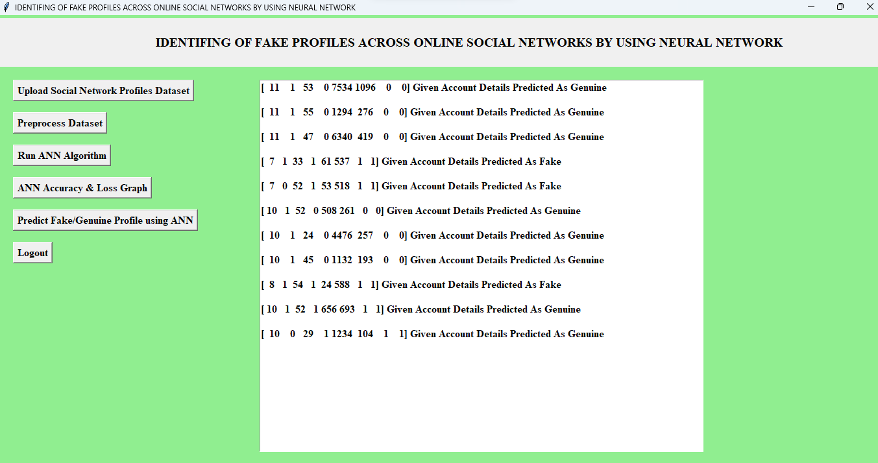

Slide 28
Conclusion
We use machine learning, namely an artificial neural network to determine the chances that a friend request is authentic or not. Each neuron (node) equation is put through a Sigmoid function. We use a training data set by social networks. This would allow the presented deep learning algorithm to learn the patterns of bot behavior by backpropagation, minimizing the final cost function and adjusting each neuron's weight and bias.

Slide 29
Future enhancement
We have used a small dataset to train the classifier, in future we can implement it on a large dataset and, we can implement it on mobile applications and desktops separately, so users can use this system on a mobile phone more efficiently for detecting fake profile. The accuracy of the proposed technique can also be improved using different feature selection techniques. Finally, we intend to enrich the dataset further and look forward to observing the results of other elements of the boosting methods.

Slide 30
Reference
Awasthi, S., Shanmugam, R., Jena, S.R. and Srivastava, A., 2020. Review of Techniques to Prevent Fake Accounts on Social Media.
Hajdu, G., Minoso, Y., Lopez, R., Acosta, M. and Elleithy, A., 2019, May. Use of Artificial Neural Networks to Identify Fake Profiles. In 2019 IEEE Long Island Systems, Applications and Technology Conference (LISAT) (pp. 1-4). IEEE.
Kaur, J. and Sabharwal, M., 2018. Spam detection in online social networks using feed forward neural network. In RSRI conference on recent trends in science and engineering (Vol. 2, pp. 69-78).
Meligy, A.M., Ibrahim, H.M. and Torky, M.F., 2017. Identity verification mechanism for detecting fake profiles in online social networks. Int. J. Comput. Netw. Inf. Secur.(IJCNIS), 9(1), pp.31-39.

Slide 31
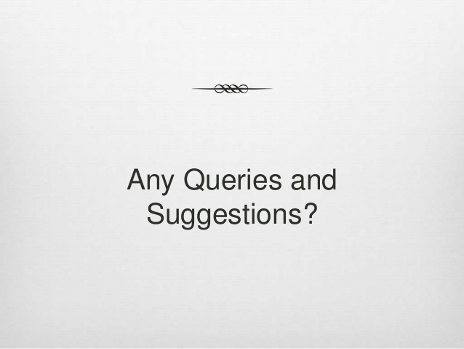

Slide 32


